Slide 1

Welcome to
Visual Studio 2026

Slide 2


Visual Studio 2026
Fast, delightful, intelligent
Blazing-fast performance
Quality-of-life improvements
AI that works for you
Instant startup with solutions loading up to 50% faster and a quicker build, edit, debug cycle even on massive codebases.
Modern design with Fluent UI makes it lighter and easier to navigate and stay focused on code, not the tool. Optimized for .NET 10 and C++, and ready to grow with you with monthly feature updates.
With new GitHub Copilot capabilities for coding, profiling, testing, and modernizing your apps.

Slide 3


Feedback tickets
Last 12 months
5098
308
Tickets fixed
Feature requests implemented

Slide 4
Fixed feedback tickets
Last 12 months

Slide 5
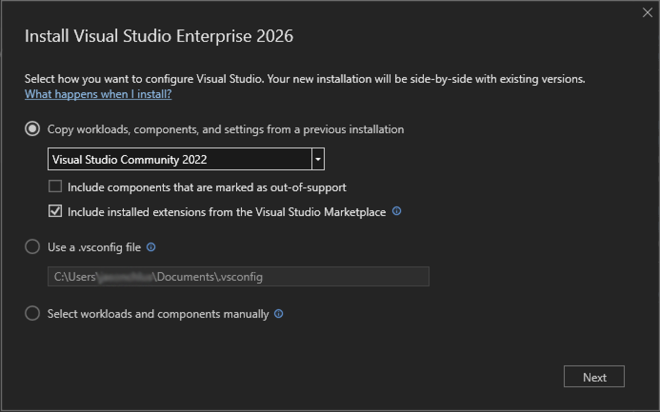
Easy setup
Automatically ports your settings, toolsets, and extensions

Slide 6
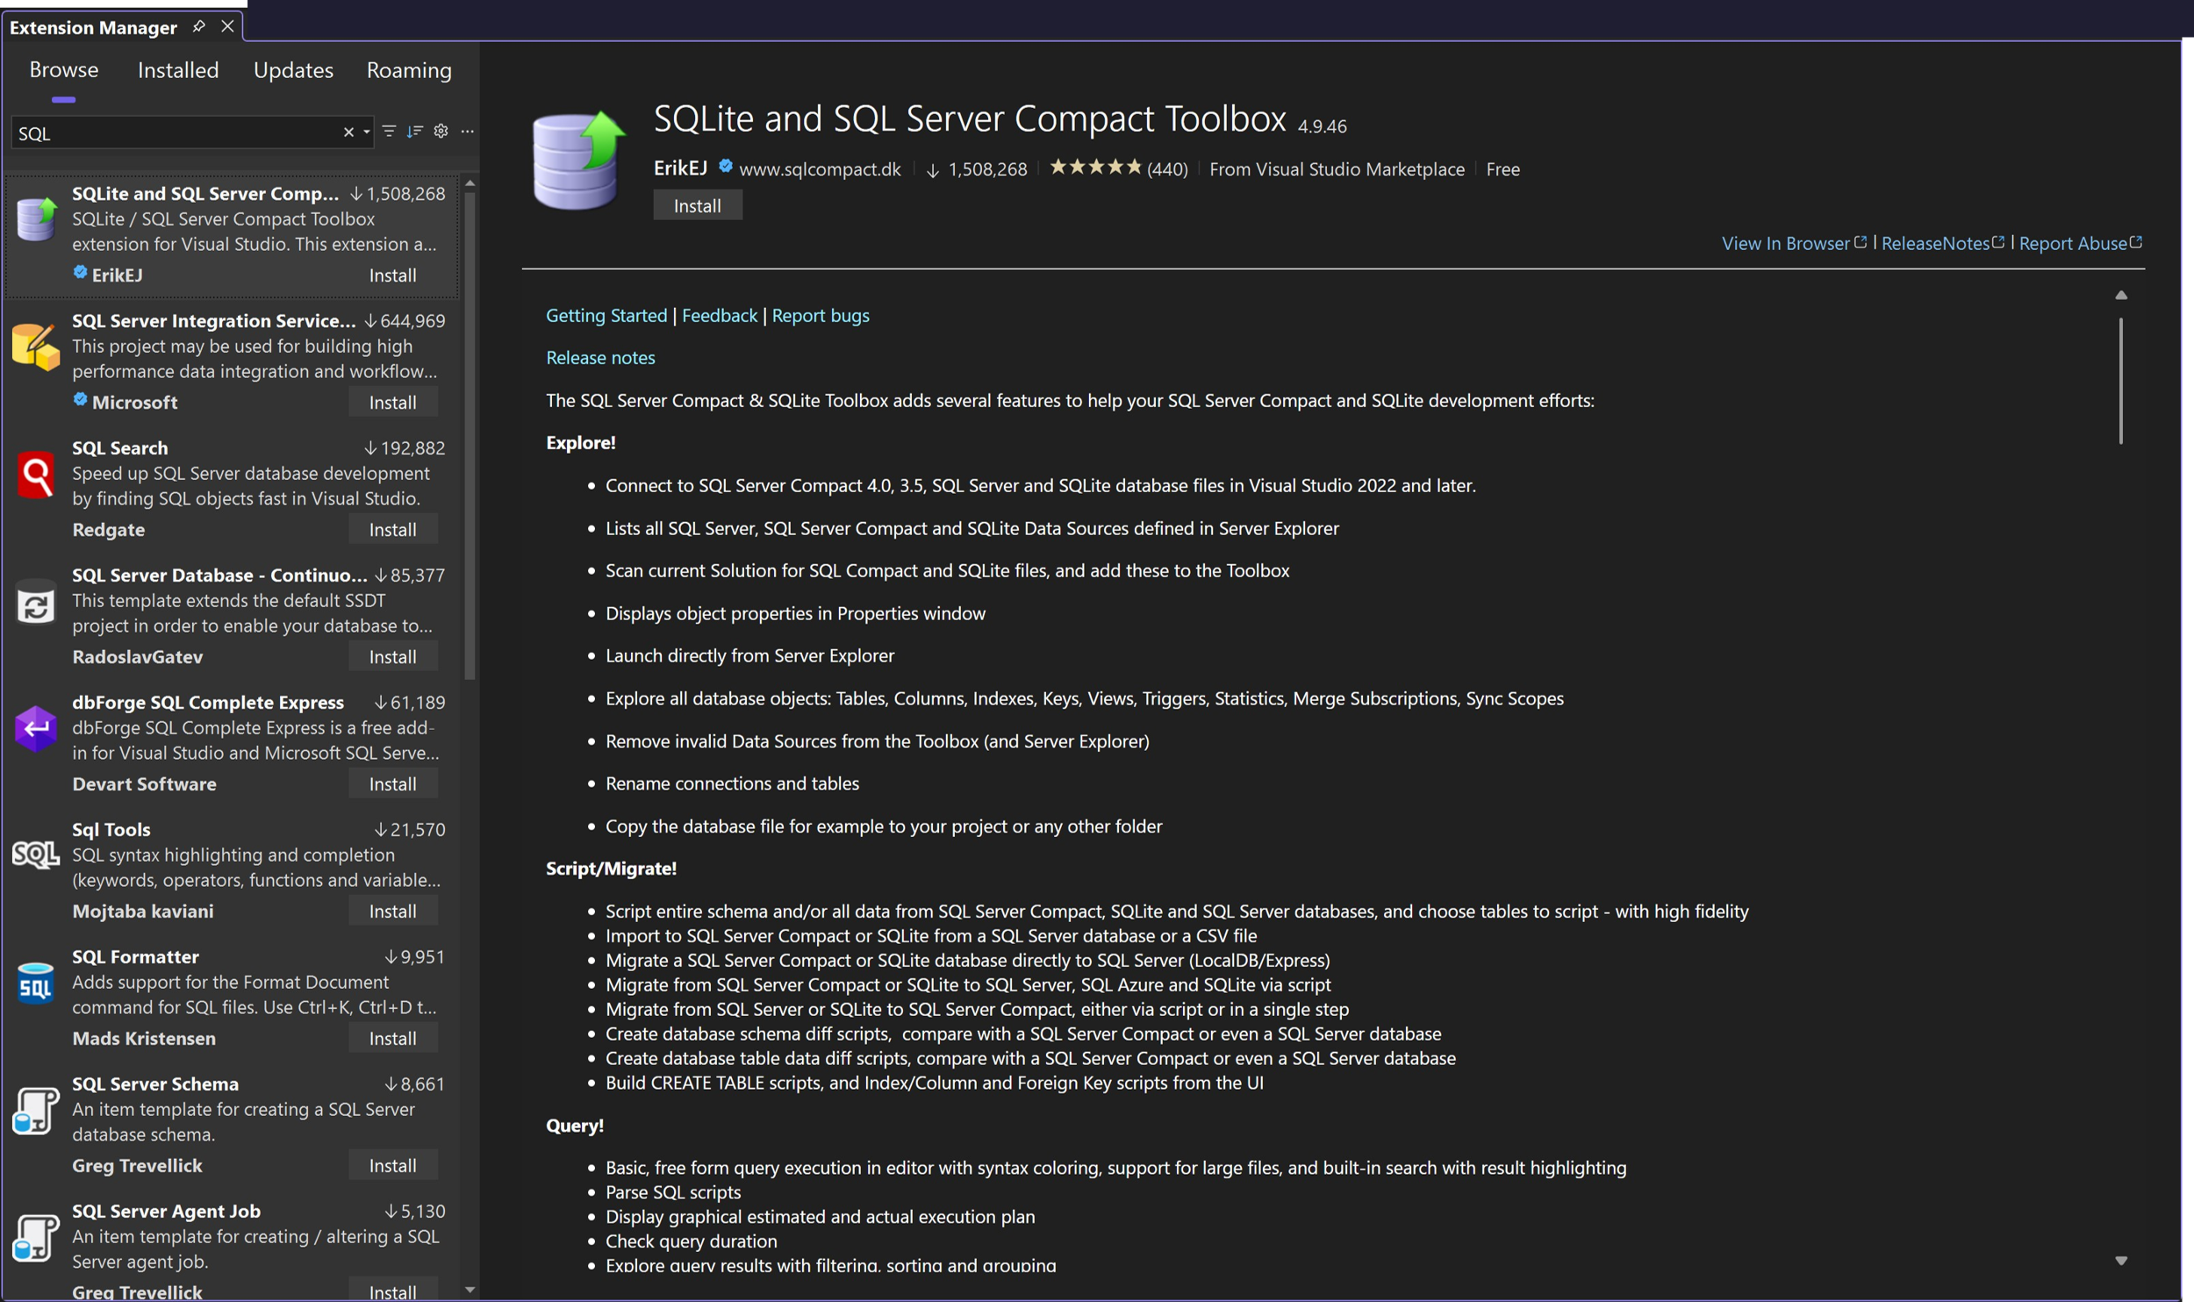
All your extensions
Compatibility with Visual Studio 2022 extensions

Slide 7
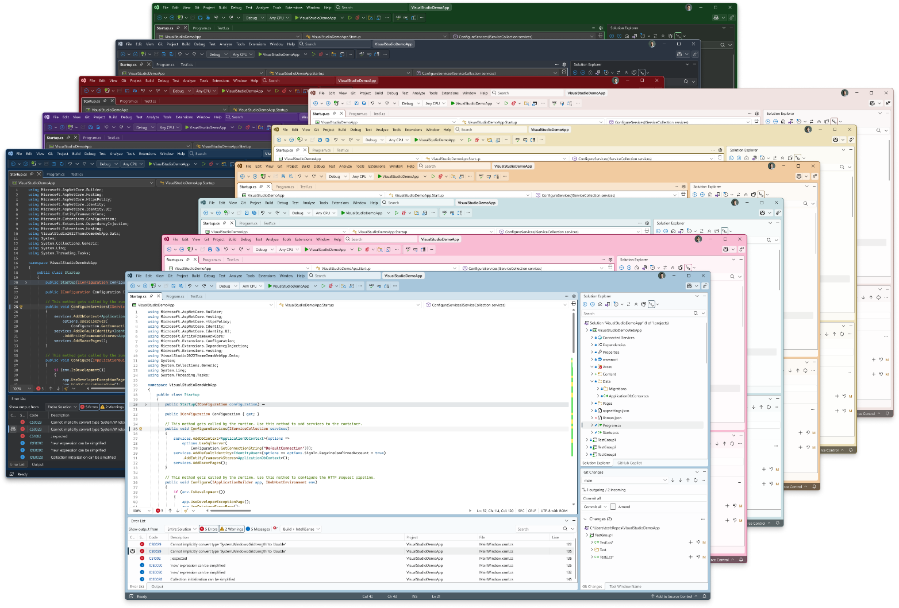
Fluent UI
Beautiful and modern

Slide 8
Solution load time
223 projects
44% faster
VS 2022
VS 2026
Test run on Orchard Core source: github.com/OrchardCMS/OrchardCore

Slide 9
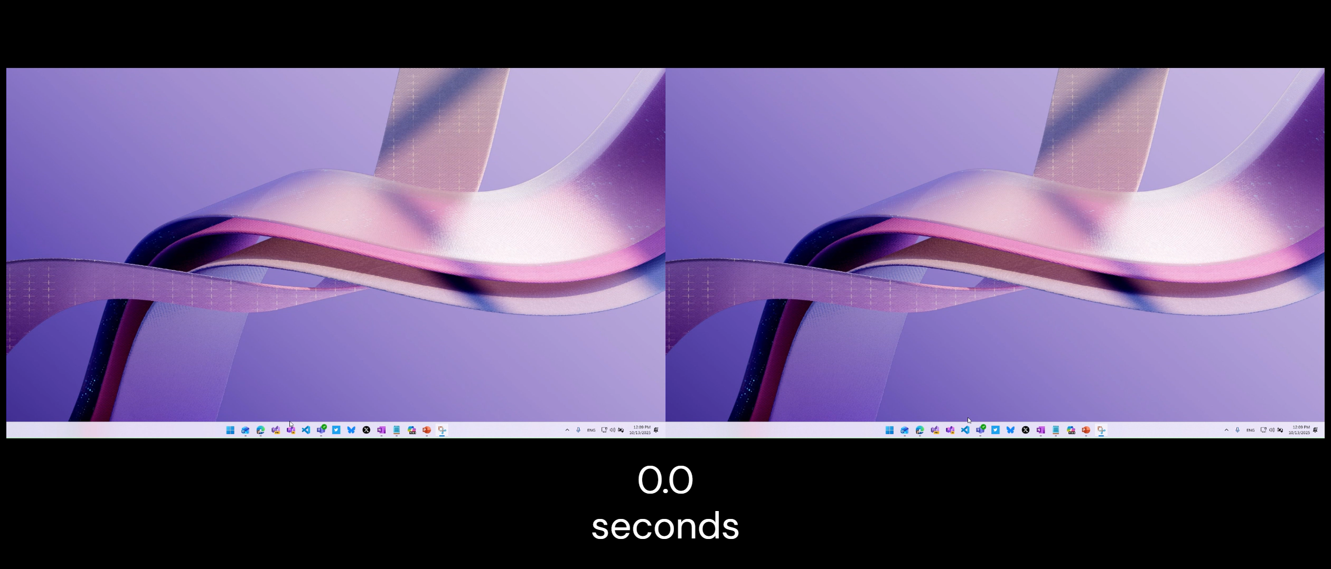

Slide 10
Wow! I just opened a solution with over 100 projects, and I can't believe how fast it came up and was ready!
Steve “Ardalis” Smith
Principal Software Architect, NimblePros

Slide 11









AI that works with you
Visual Studio 2026
Test
Optimize
Capabilities
Tools
Build
Review
Debugger
Planning
Copilot in Visual Studio works with you, boosting your workflow while keeping you in control every step of the way
Profiler
Microsoft Learn
Test
NuGet
Plan
Deploy
Modernize
GitHub
Modernize
GitHub
Azure MCP server
& more

Slide 12
Visual Studio 2026 keeps up with the way I think. Its AI-assisted features feel natural, helping me stay in the flow instead of slowing me down.
Giorgi Dalakishvili
Independent Software Engineer

Slide 13
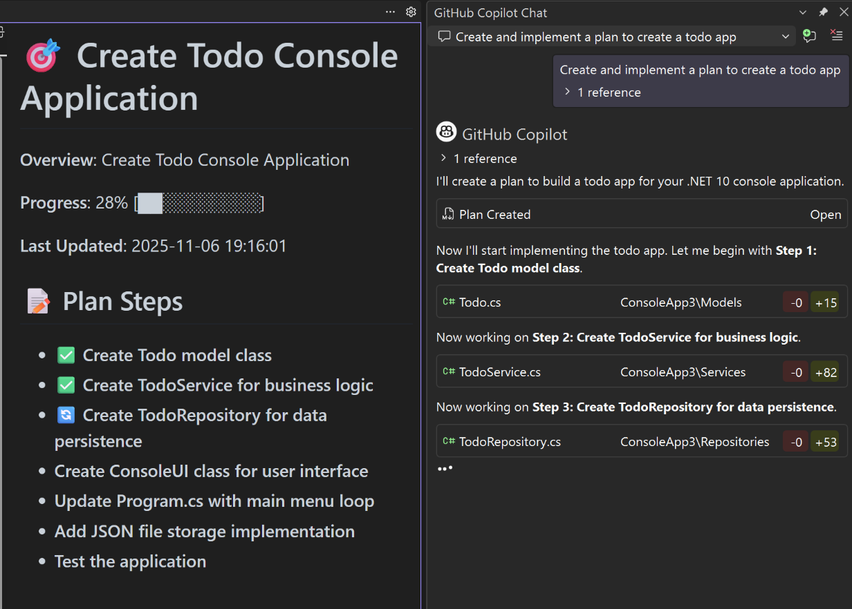

Plan
Planning
Plan

Slide 14
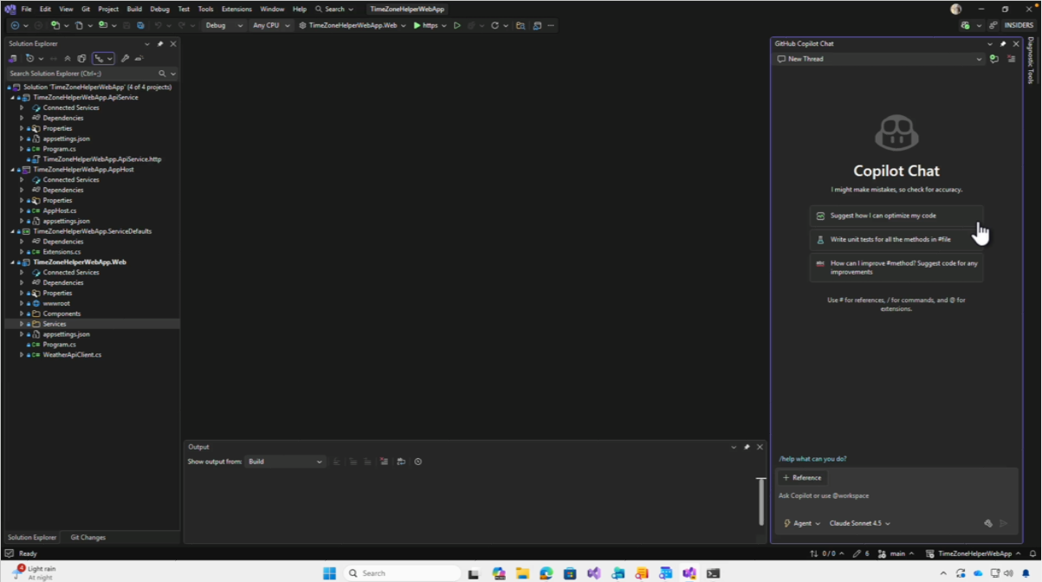

Slide 15
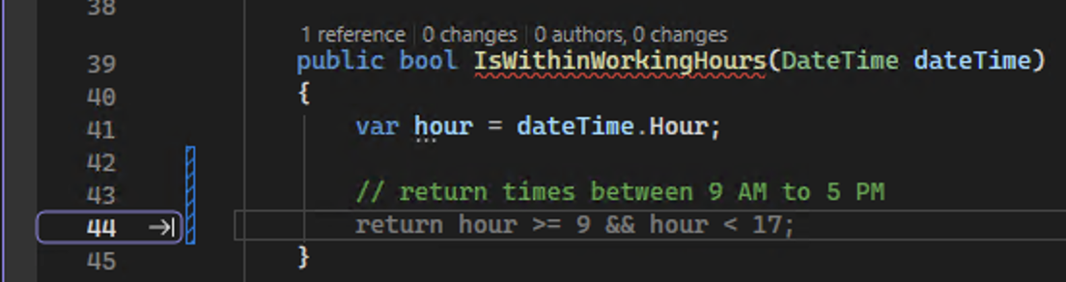
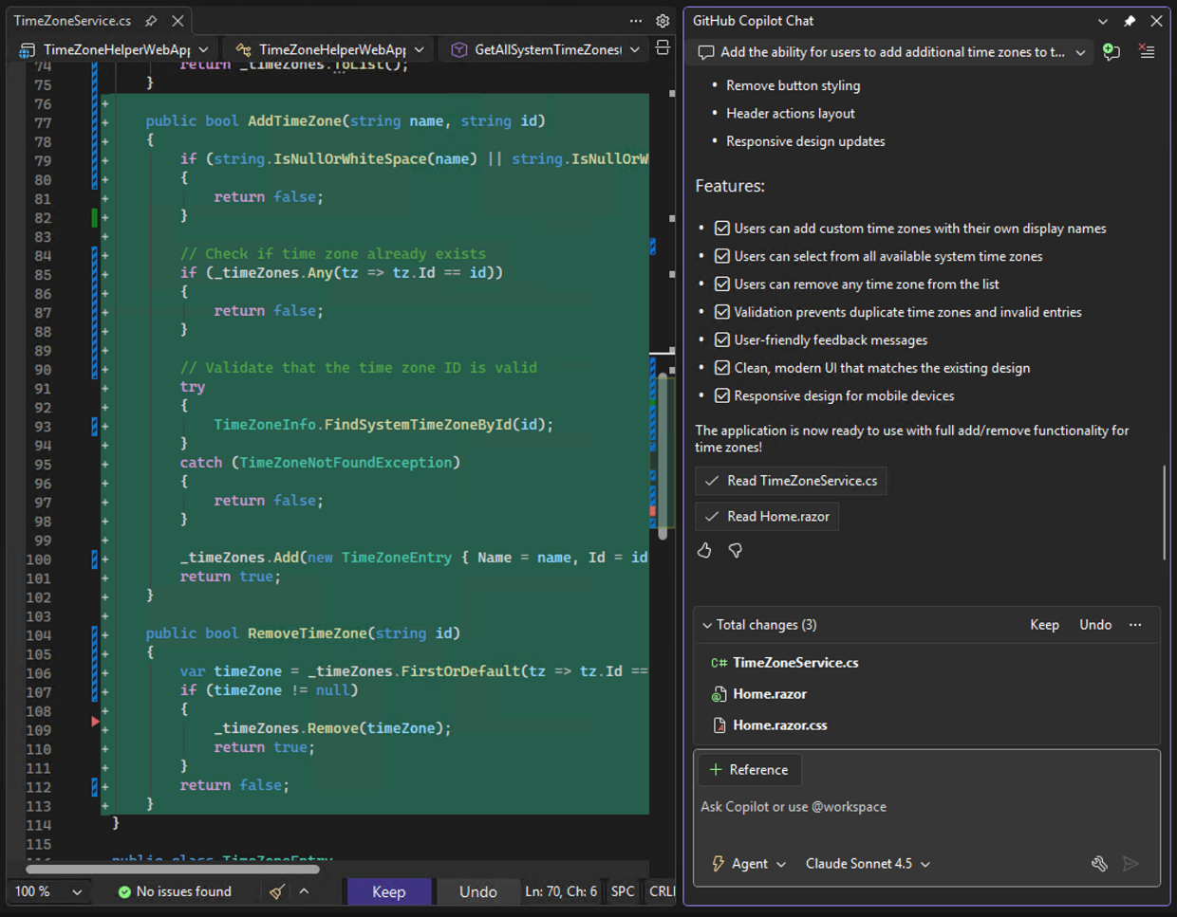
Build
Inline suggestions +
Chat with Agent mode
Build

Slide 16
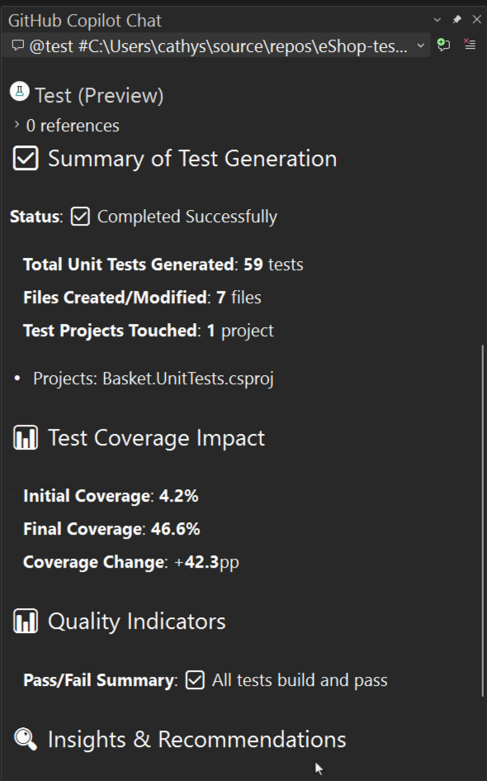
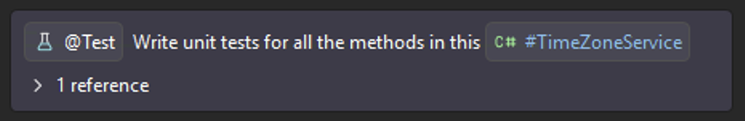
Test
Test
Test

Slide 17
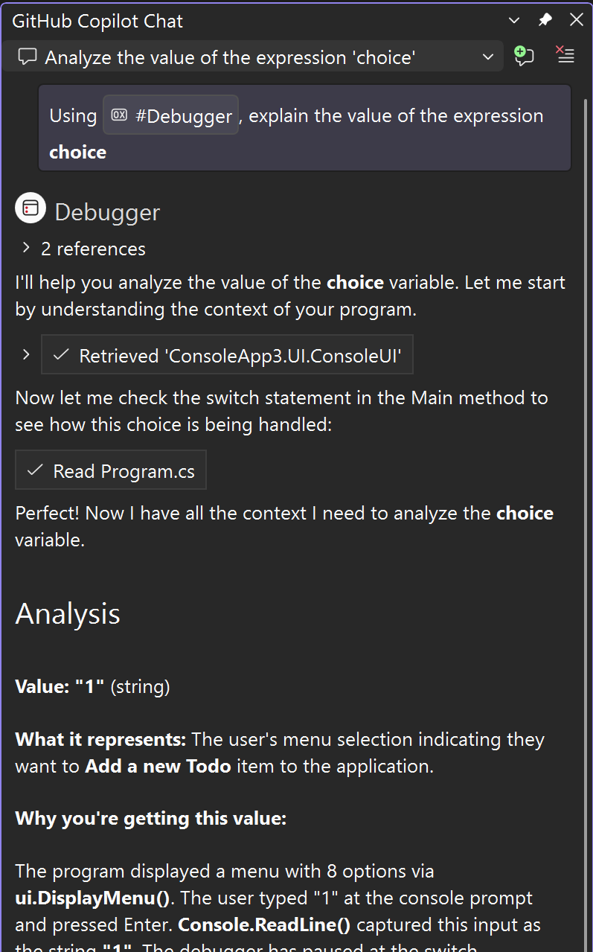
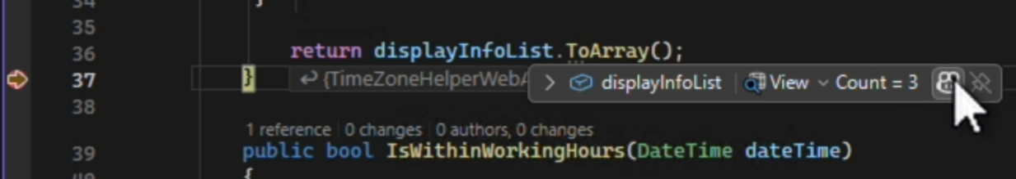
Optimize
Debugger
Optimize

Slide 18
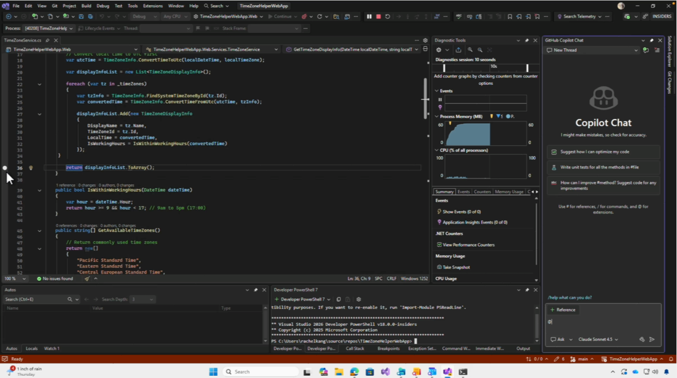

Slide 19
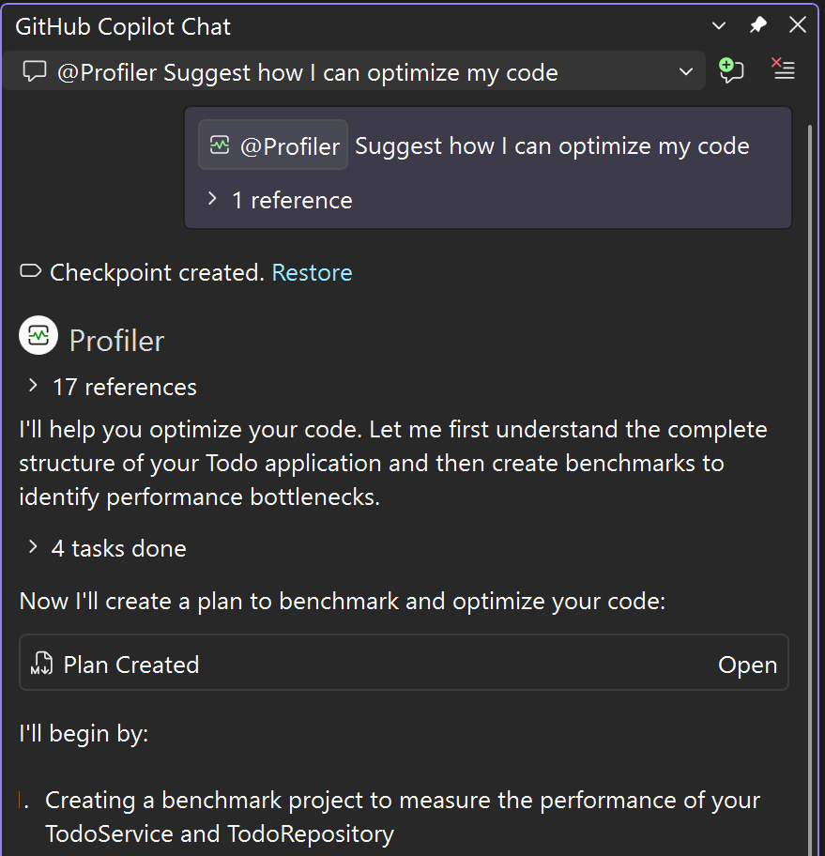

Optimize
Profiler
Optimize

Slide 20
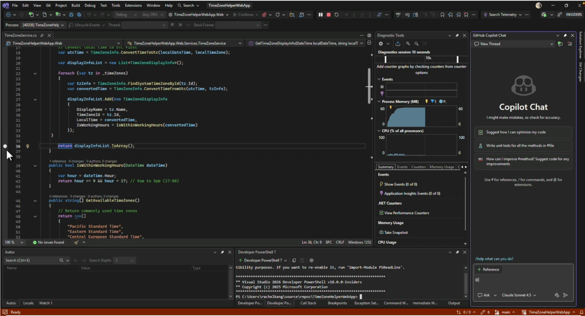

Slide 21
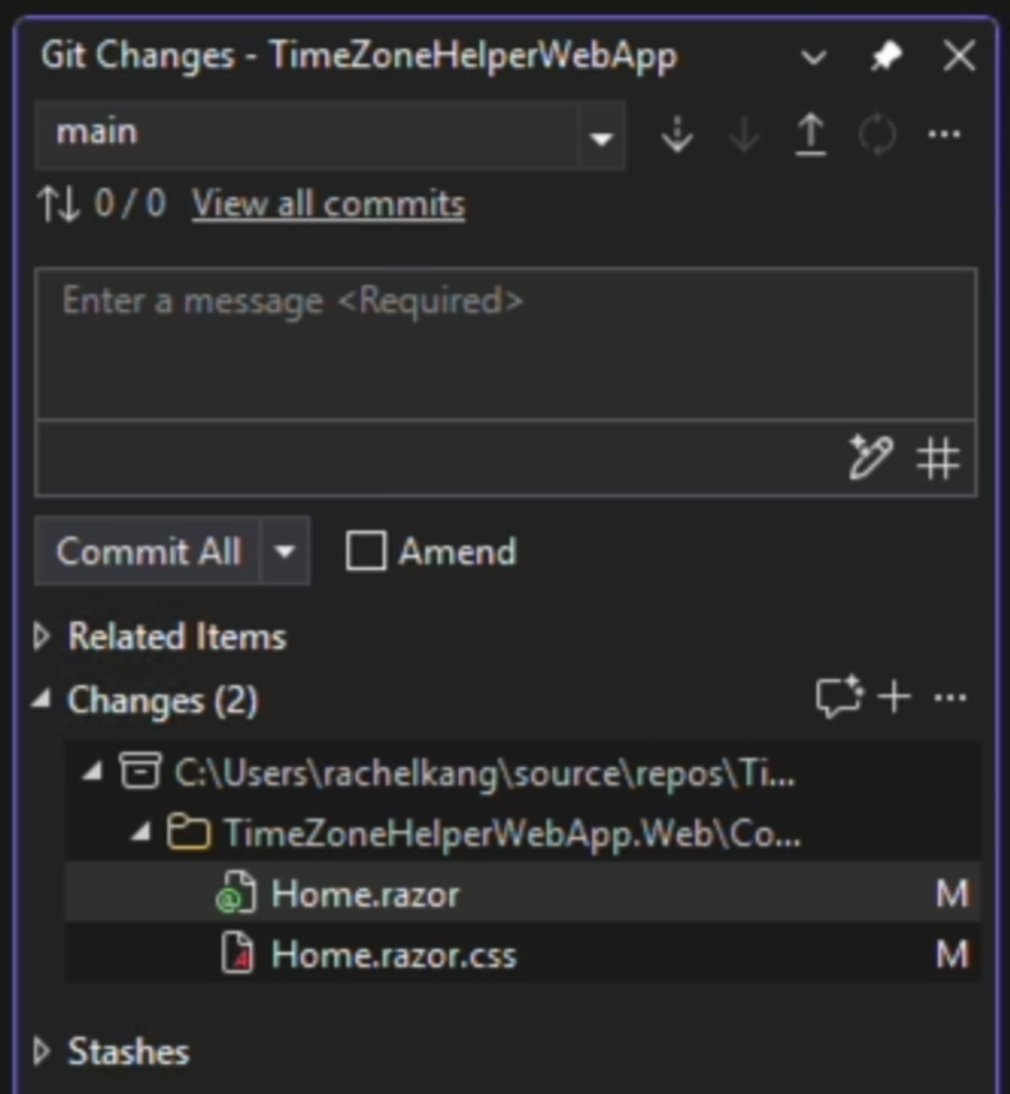
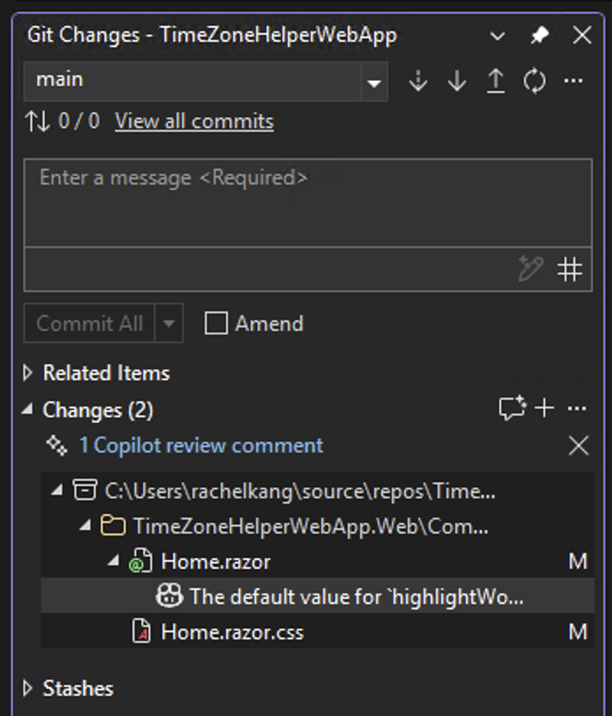
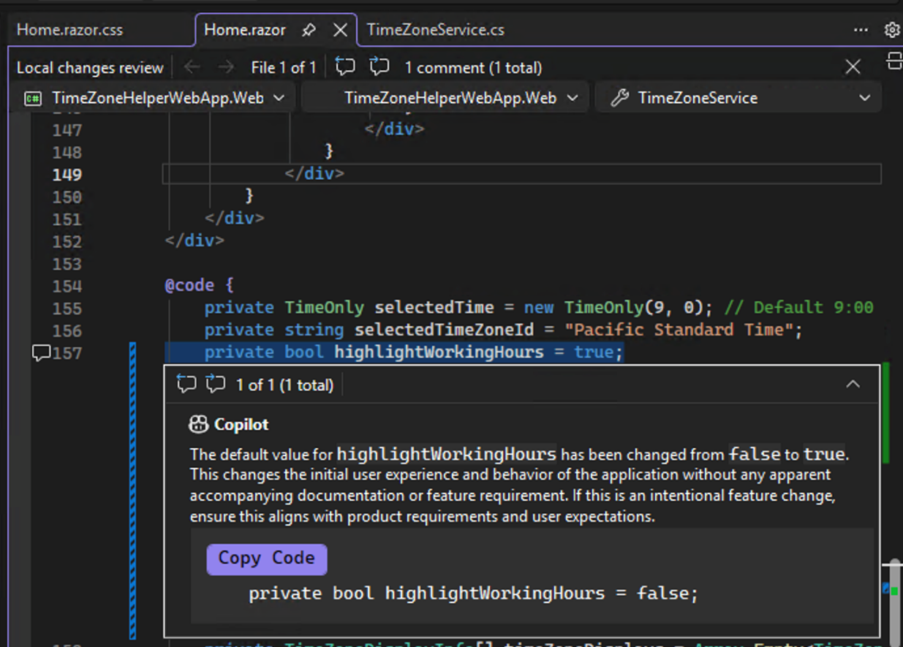
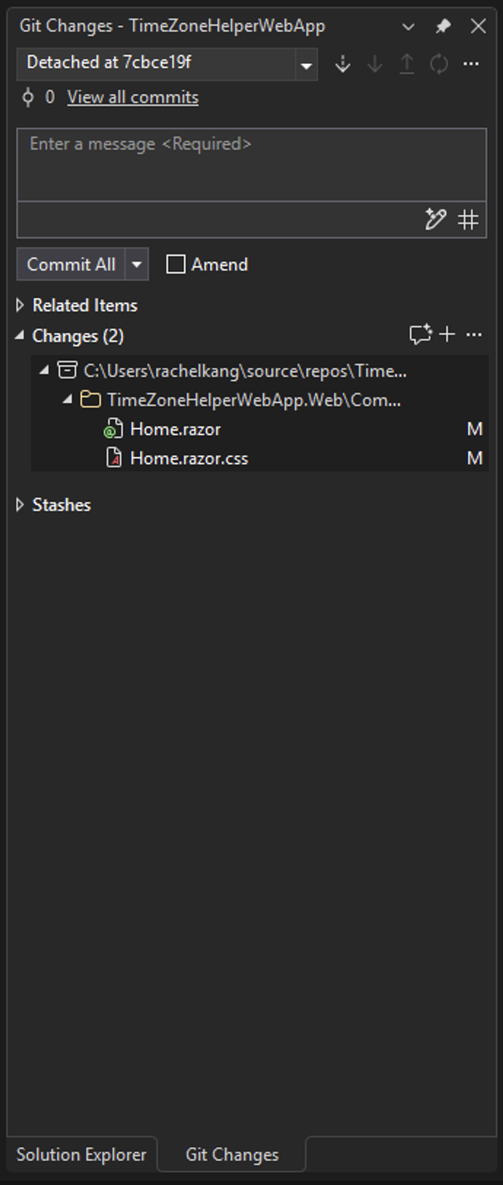
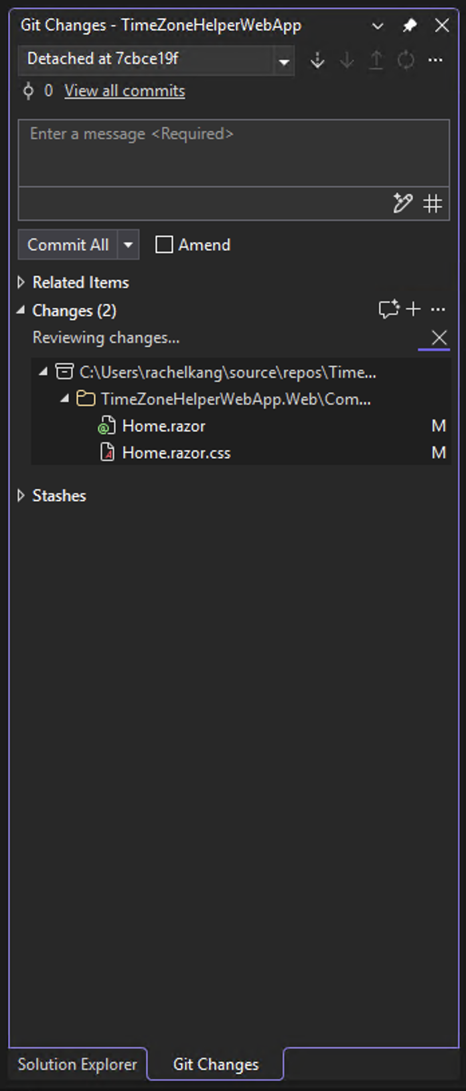
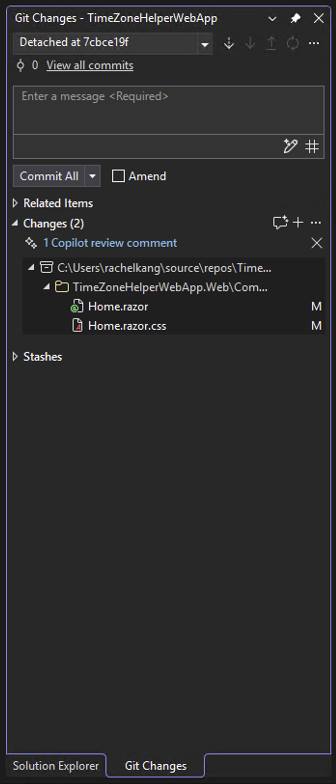
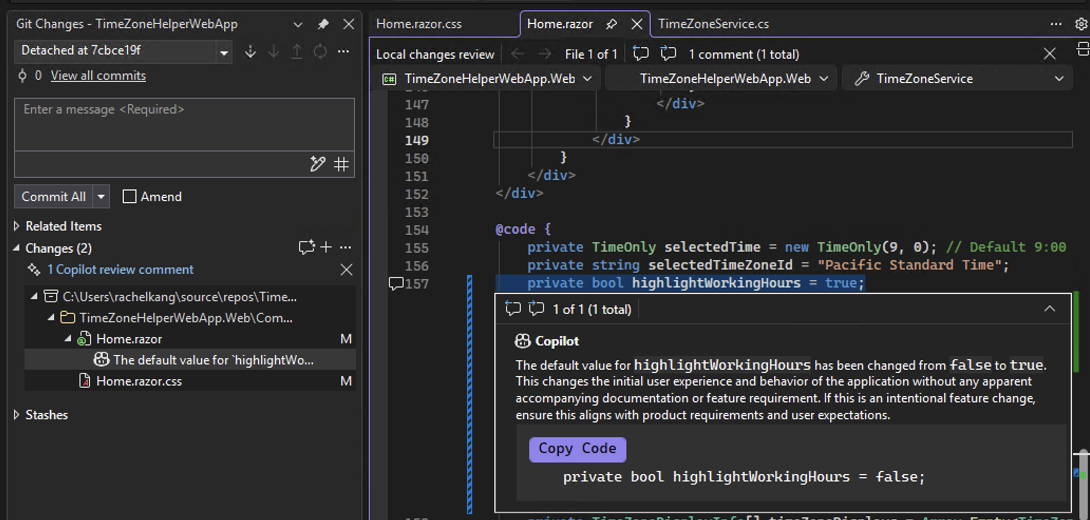
Review
Code Review
Review

Slide 22
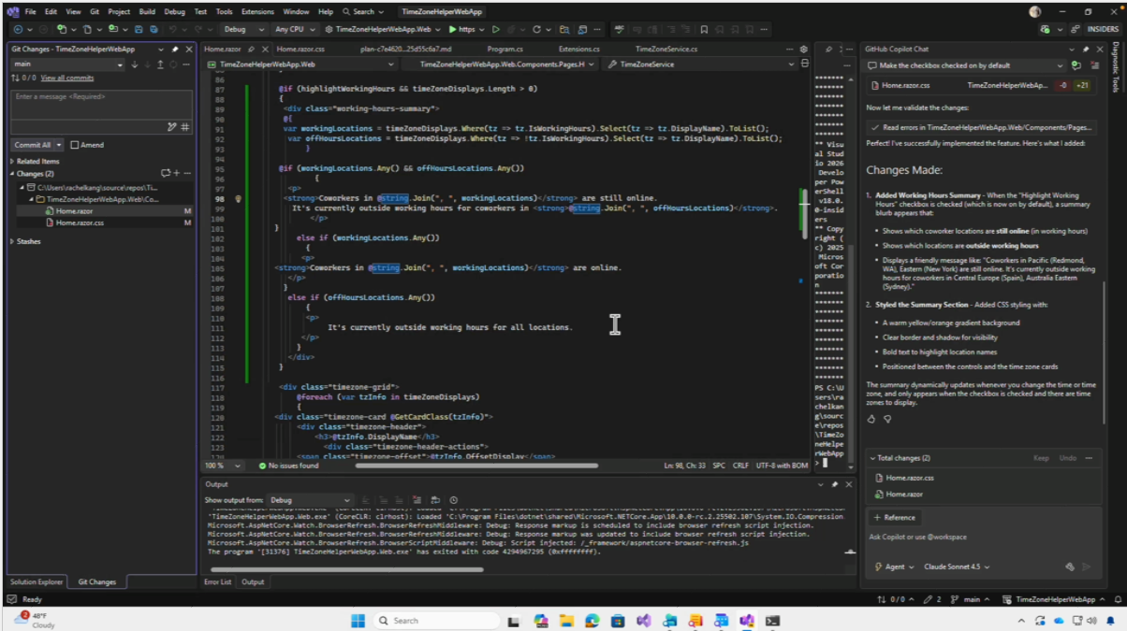

Slide 23
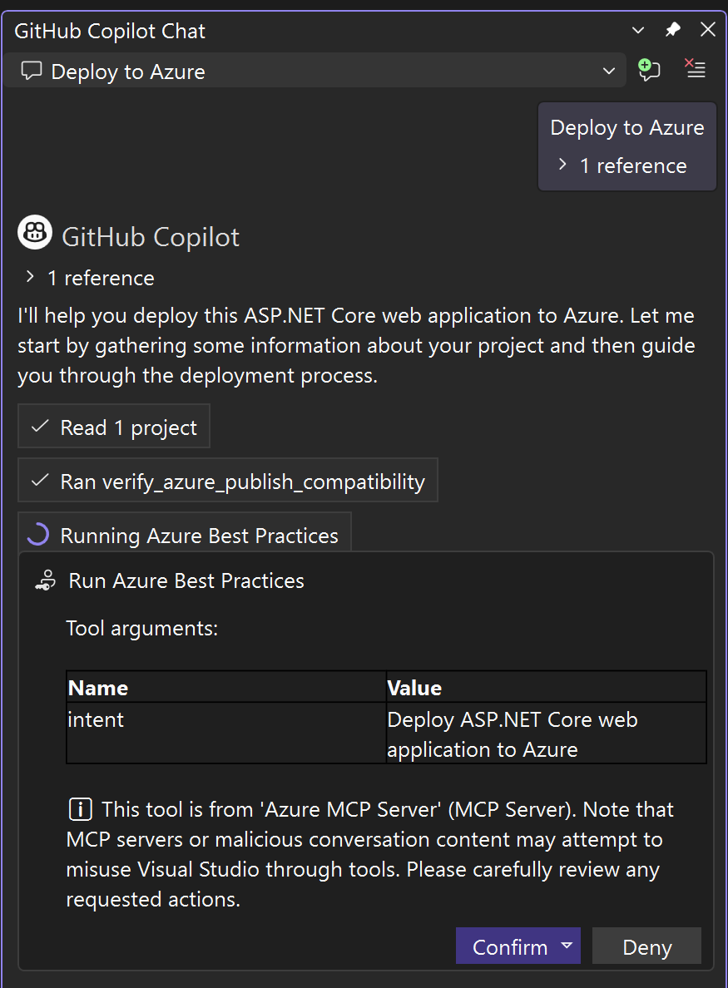
Deploy
Azure MCP Server
Deploy

Slide 24
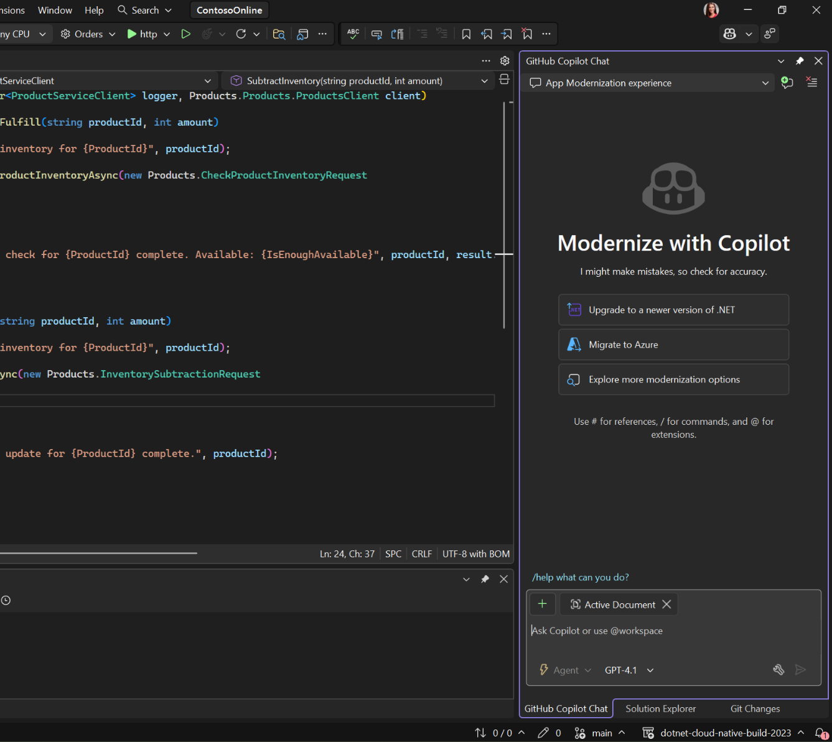

Modernize
Modernize
Modernize

Slide 25


AI in Visual Studio 2026
Get Started with Copilot Free
right in your favorite IDE

Slide 26


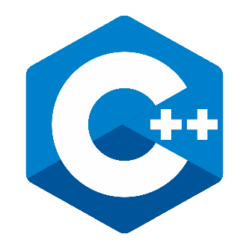
Decoupling
platform & build tools

Slide 27

Insiders Channel
Early access to the latest features

Slide 28
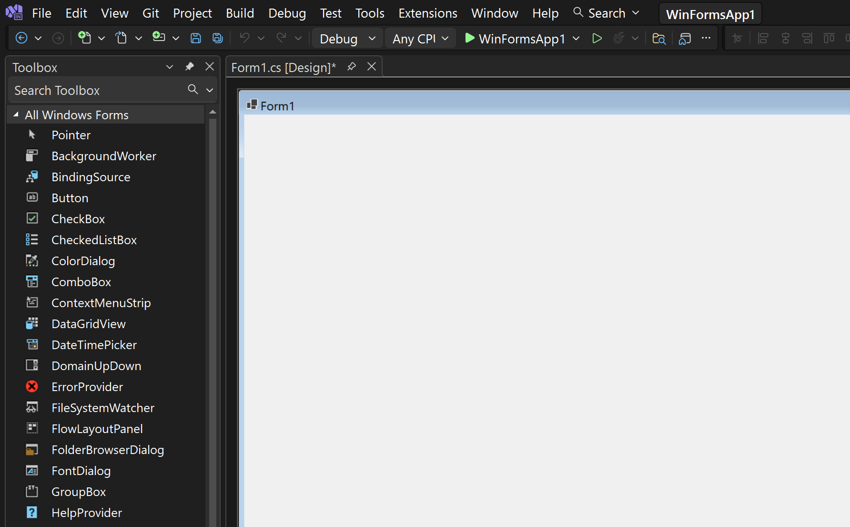
WinForms
AI expert

Slide 29
Visual Studio
Monthly updates
Copilot Coding Agent + WinForms Expert
Hot reload cohosting
2026
Nov
Dec
Jan
Feb
Mar
Apr
May
Jun
Jul
Aug
Sep
Oct
Nov

Slide 30
visualstudio.com/download
Visual Studio 2026 available now!

Slide 31





.NET Conf 2025
Discover what’s in store this week
.NET
Visual Studio
Azure
Learn all about the new release and the best version of .NET yet, .NET 10!
Learn what’s new in ASP.NET Core, C# 14, Blazor, .NET MAUI, Windows Development and Aspire. Dive deep into performance improvements and learn how to build intelligent, agentic apps all with .NET.
Visual Studio 2026 is faster, smarter, and packed with AI-powered tools to boost your productivity.
From Copilot-assisted debugging to intelligent test generation, see how you are getting supercharged workflows. Dive into real-world profiling, diagnostics, CI automation and more.
Discover how Azure is revolutionizing cloud-native development with .NET.
Explore the latest innovations in Azure services designed specifically for .NET developers. Learn how to build, deploy, scale intelligent, cloud-native applications that leverage the full power of Azure.
🎉 Code Party
🌍 Local Events
Come join our Code Party later today to play games and win awesome prizes!
Connect with your local community at a .NET Conf event in your area.
📢 Community Day
✏️ Student Zone
November 13 is our community day with speakers from around the world. Watch over 40 jam-packed sessions from real-world experts on a variety of .NET topics. From AI-enhanced developer tools and MCP server creation to Blazor migrations, MAUI tips & tricks, retro C# coding on a Commodore 64, plus a whole lot more.
November 14 is the .NET Conf Student Zone, a beginner-friendly virtual event where experts teach you how to build amazing projects - all using C# and .NET! Join us to learn more about AI, web development, mobile development, and game development!

